Slide 1
ASME-CIE Hackathon 2021
Hackathon Problem 1: Digital Manufacturing – Obfuscating the design with security features
Gary Mac
08.14.2021

Slide 2


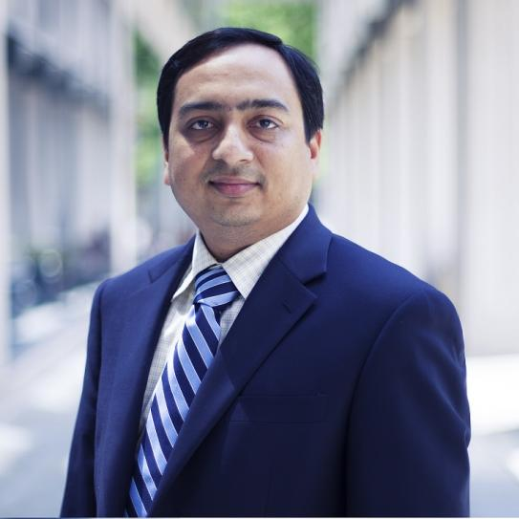
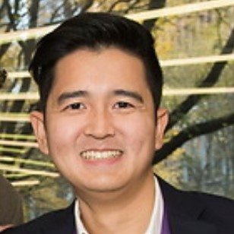

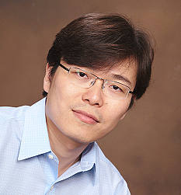
Organizers & Mentors
Nikhil Gupta
Professor
Mechanical & Aerospace Engineering
NYU Tandon
Gary Mac
Ph.D Researcher
Mechanical & Aerospace Engineering
NYU Tandon
Hammond Pearce
Postdoctoral Associate
Computer Systems Engineering
NYU Tandon
Zhenghui Sha
Assistant Professor
Mechanical Engineering
University of Texas at Austin

Slide 3
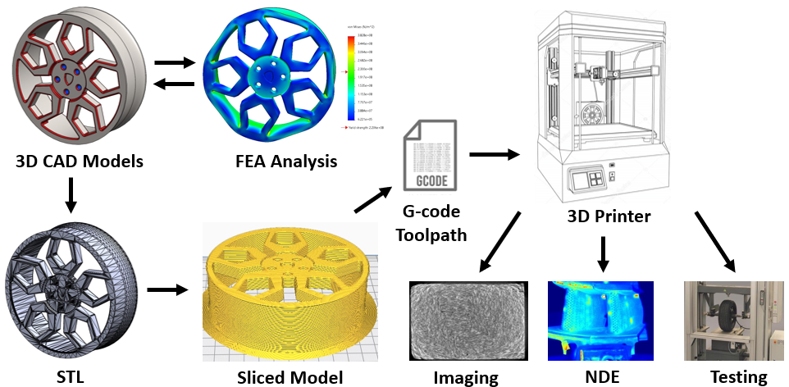
Additive Manufacturing (AM) Process
Cyber-physical system that includes design files, computers, and 3D printers
Research Focus: Digital manufacturing
Cybersecurity
Cyber-physical systems
Reverse engineering
File manipulation
CAD/STL/G-code
Software and hardware

Slide 4
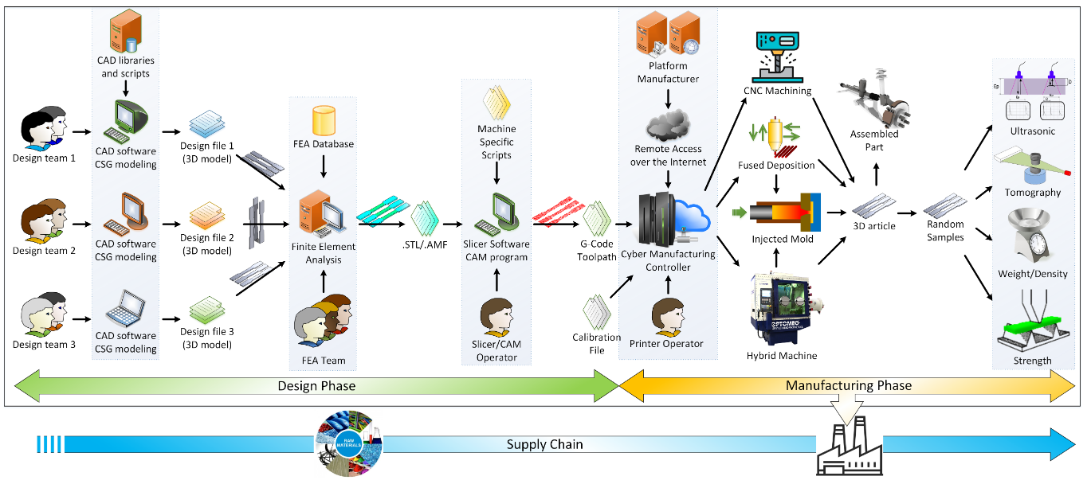
AM Process Chain

Slide 5
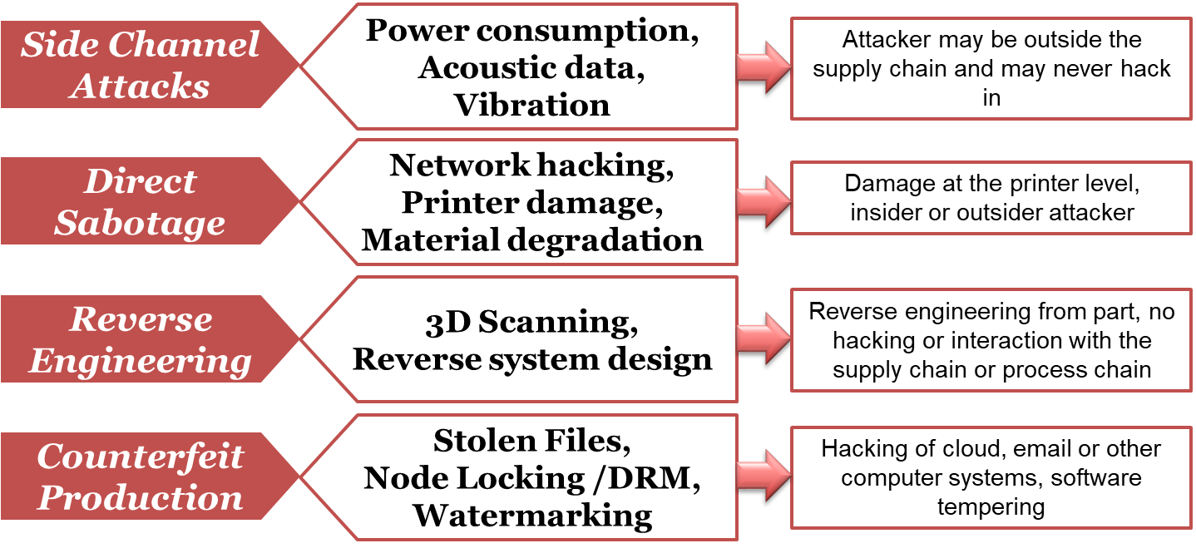
Threat Vectors

Slide 6
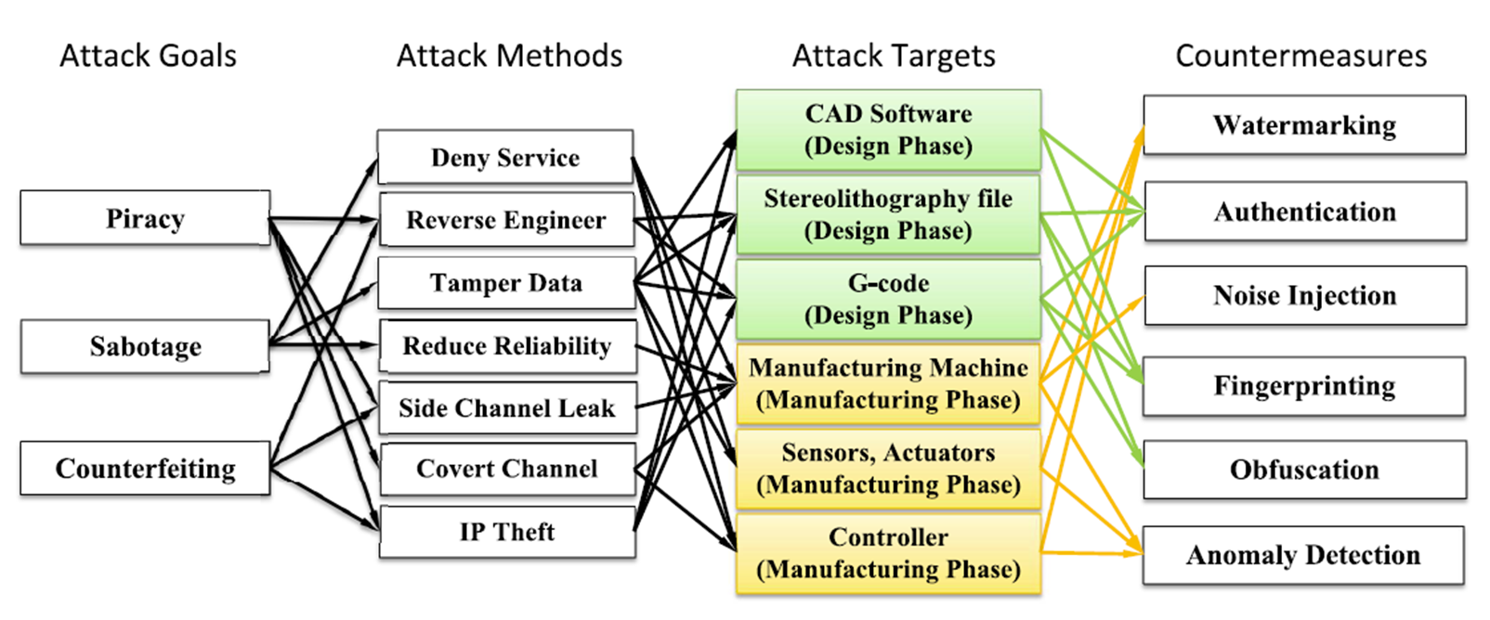
Attack Taxonomy

Slide 7
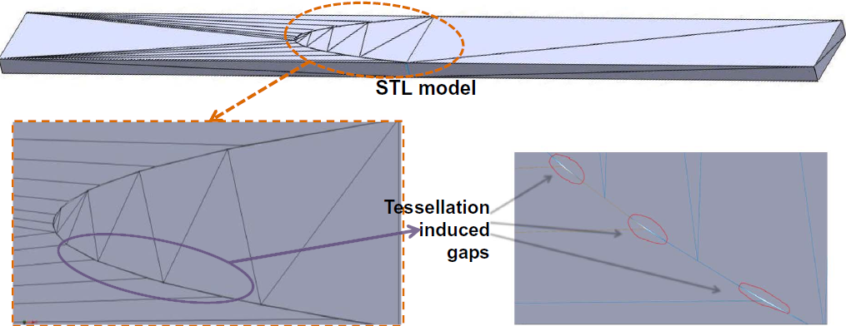
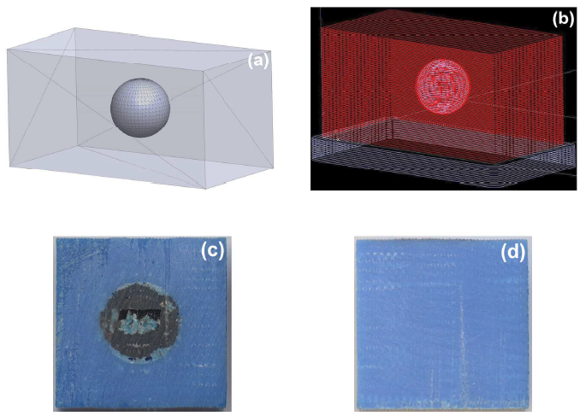
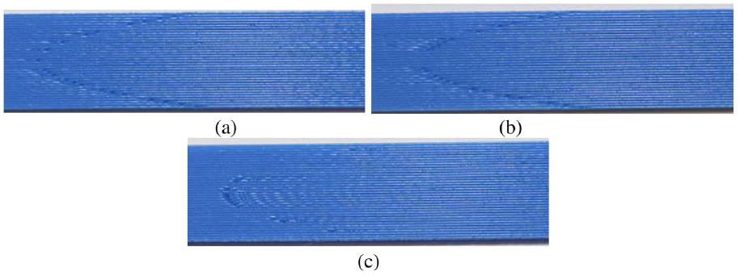
Research – Surface Markings & Embedded Code
https://doi.org/10.1016/j.matdes.2017.04.078

Slide 8
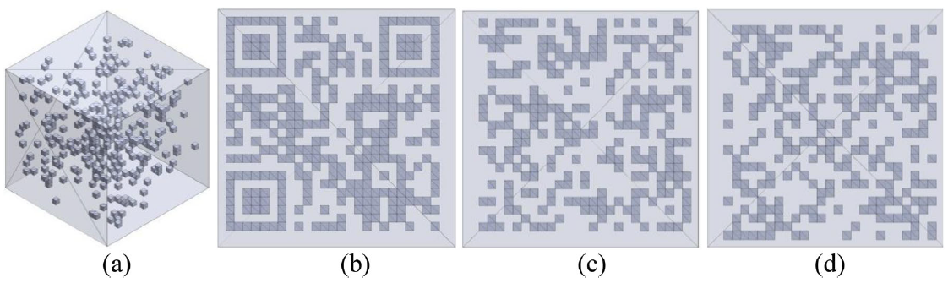
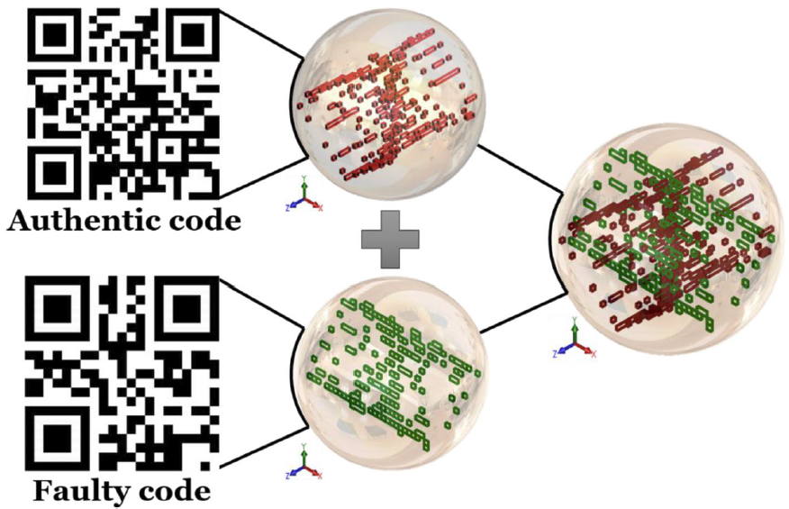
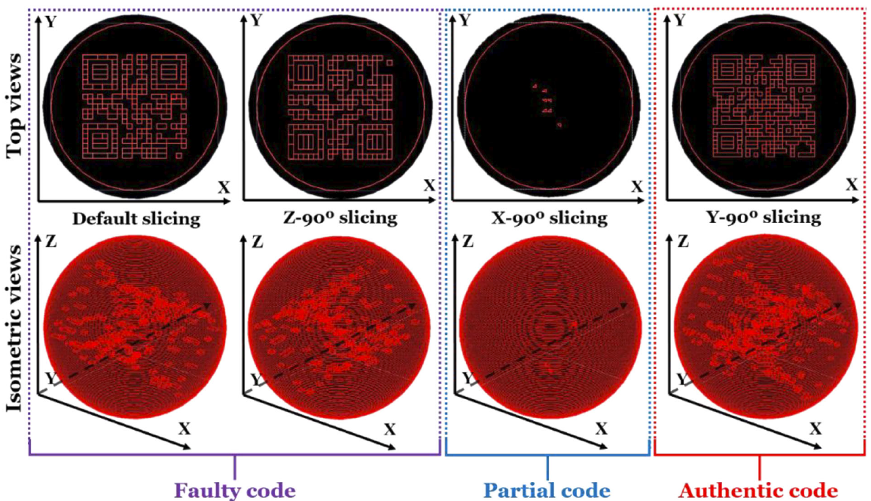
Embedded QR Codes
https://doi.org/10.1002/adem.201900146

Slide 9
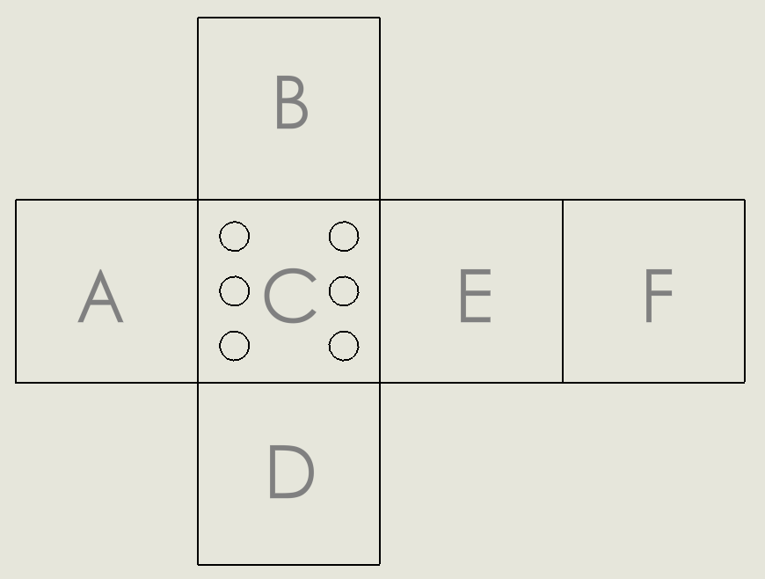
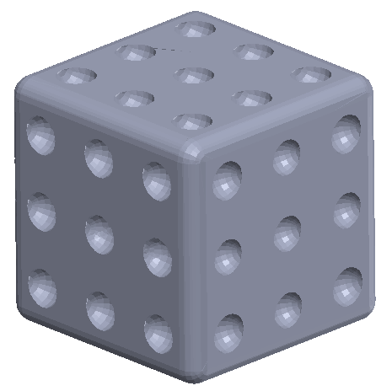
Hackathon Problem 1
Custom 6-sided dice (STL file format)
Find evidence to make a convincing argument on what number each side represents
Die face letter | Die face value/number | Clue
A | ?
B | ? | “Mountaintops inspire leaders, but valleys mature them”
C | 6 | “The best practice is to follow the advice posted on every railroad crossing. Stop to look at both sides.”
D | ?
E | ?
F | ?

Slide 10
Hackathon Problem 1 - Submission
A detailed word document
Submission table for each die face value
A description of the brainstorming process
A summary of any other approach attempted
Complete the “Submission Template.csv”
Any supplementary file to support your report
Die face letter | Die face value/number | Clue
A | ?
B | ? | “Mountaintops inspire leaders, but valleys mature them”
C | 6 | “The best practice is to follow the advice posted on every railroad crossing. Stop to look at both sides.”
D | ?
E | ?
F | ?

Slide 11
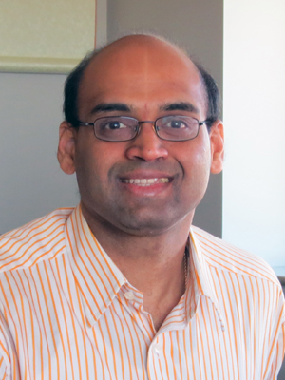
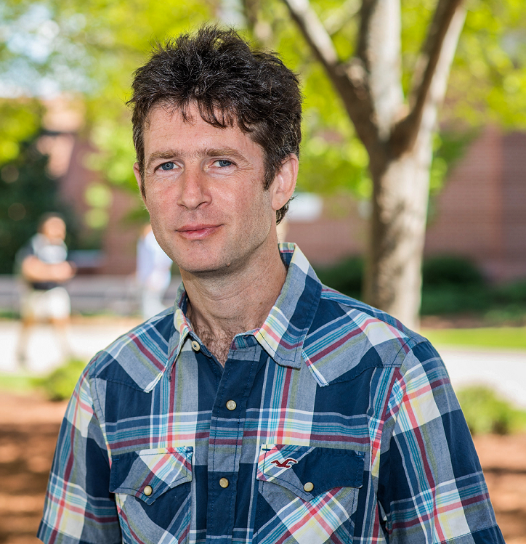
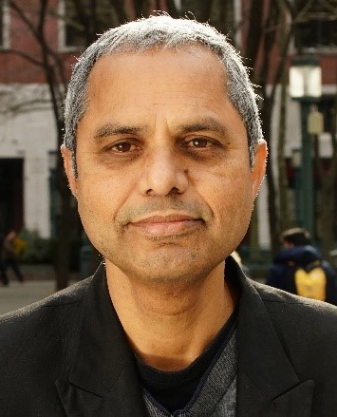
Hackathon Problem 1 - Judges
Satish Bukkapatnam
Professor Industrial & Systems Engineering
Texas A&M University
Mark Yampolskiy
Associate Professor Computer Science and Software Engineering
Auburn University
Ramesh Karri
Professor Electrical and Computer Engineering
NYU Tandon

Slide 12
ASME-CIE Hackathon 2021
An Overview to Digital Manufacturing
Gary Mac
08.14.2021

